Slide 1
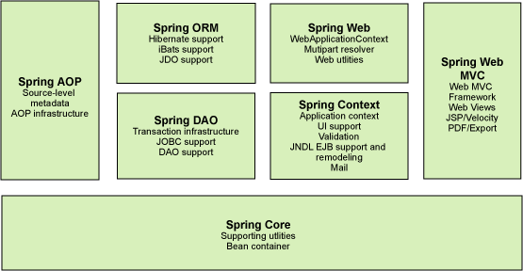
Spring Framework - Architecture
Spring is the de-facto standard in lightweight enterprise application framework.
Spring is an open source framework created to address the complexity of enterprise application development.
One of the main advantages of the Spring framework is its layered architecture, which allows you to be selective about which of its components you use while also providing a consistent framework for J2EE application development.

Slide 2
Spring Framework - Architecture
The core container provides the fundamental functionality of the Spring framework. In this module primary component is the BeanFactory, an implementation of the Factory pattern.
The BeanFactory applies the Inversion of Control (IOC) pattern to separate an application's configuration and dependency specification from the actual application code.

Slide 3
Spring Framework - Architecture
The Spring context is a configuration file that provides context information to the Spring framework.
The Spring context includes enterprise services such as e-mail, JNDI, EJB, internalization, validation, scheduling and applications lifecycle events. Also included is support for the integration with template frameworks such as velocity.

Slide 4
Spring Framework - Architecture
The Spring AOP module allows a software component to be decorated with additional behavior, through its configuration management feature. As a result you can easily AOP-enable any object managed by the Spring framework.
The Spring AOP module provides transaction management services for objects in any Spring-based application. With Spring AOP you can incorporate declarative transaction management into your applications without relying on EJB components.

Slide 5
Spring Framework - Architecture
The Spring DAO module provides a JDBC-abstraction layer that reduces the need to do tedious JDBC coding and parsing of database-vendor specific error codes.
Also, the JDBC package provides a way to do programmatic as well as declarative transaction management, not only for classes implementing special interfaces, but for all your POJOs (plain old Java objects).

Slide 6
Spring Framework - Architecture
Spring provides integration with OR mapping tools like Hibernate, JDO and iBATIS.
Spring transaction management supports each of these ORM frameworks as well as JDBC

Slide 7
Spring Framework - Architecture
The Web context module provides basic web-oriented integration features builds on top of the application context module, providing contexts for Web-based applications. As a result, the Spring framework supports integration with Jakarta Struts.
The Web module also eases the tasks of handling multi-part requests and binding request parameters to domain objects.

Slide 8
Spring Framework - Architecture
Spring provides a pluggable MVC architecture. The users have a choice to use the web framework or continue to use their existing web framework.
Spring separates the roles of the controller; the model object, the dispatcher and the handler object which makes it easier to customize them.
Spring web framework is view agnostic and does not push the user to use only JSPs for the view. The user has the flexibility to use JSPs, XSLT, velocity templates etc to provide the view.

